Slide 1



Supply and Delivery of DevOps CSET Enterprise Application + Database Revamp with ETL for TTdC
No Problem Left Unsolved
16th June 2025
Prepared by Giam Kai Yi | Reviewed by Angeline Mashuri Cheah

Slide 2


Quandatics Group
quandaticsgroup.com
We live in a world where businesses are increasingly technology and data-driven. It has become imperative for organizations to transform digitally to gain competitive advantage. As a boutique business and technology consulting group, Quandatics stands as the leading enabler of digital transformation in Asia Pacific. We are dedicated to assist our clients to advance through this transformative journey by cultivating a culture of technology adoption for a future of innovation and success.
quandatics
9
Countries
covered
380+
Unique
clients
270+
Projects
delivered

Slide 3

Mission, Vision, Values
Mission
To empower end-to-end digital transformation strategies
Vision
Leading the world towards a future of higher efficiencies and data-driven decisions
Values
Credible
Commitment
Mutual Success

Slide 4
Key Pillars in Digital Transformation
Customer Experience
Process Optimization
Cultural Empowerment
Business Model Innovation
Technology Adoption
7 Pillars of Digital Transformation
Data Utilisation
Security & Compliance
Business Problems
Business Outcomes

Slide 5
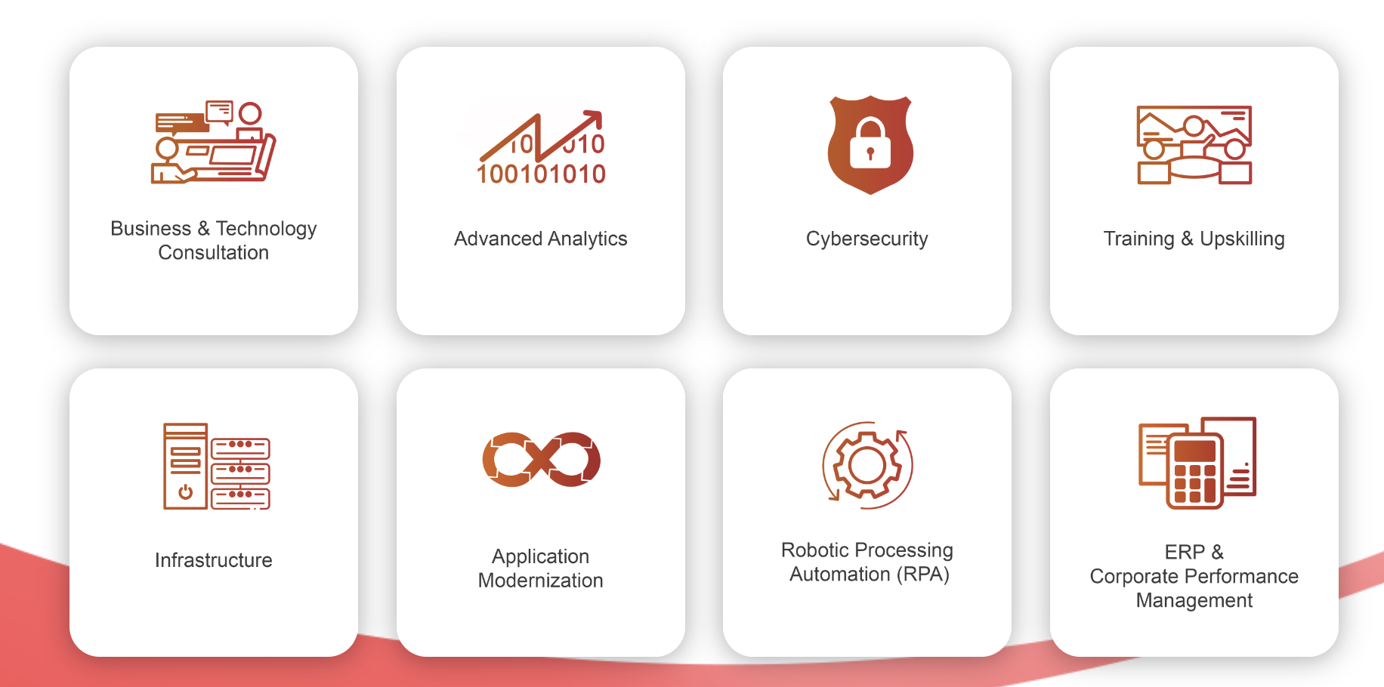

Our Domains
Business & Technology Consulting
Advanced Analytics
Cybersecurity
Robotic Processing Automation (RPA)
Advanced Analytics
Cybersecurity
Application Modernization
ERP & Corporate Performance Management (CPM)
Infrastructure
Training & Upskilling

Slide 6

















Our Technology Partners
Advanced Analytics
RPA
ERP & Corporate Performance Management

Slide 7










Our Technology Partners
Cybersecurity
Application Modernization

Slide 8




































Our Clientele

Slide 9



























Our Clientele

Slide 10













Our Clientele
and many more…

Slide 11




Quandatics’ Qualification
10 Years of data analytics
Implementation Experience
Data Related Skillset:
Data Visualization
Data Governance and Compliance
Data Integration and ETL (Extract, Transform, Load)
Data Modelling and Warehousing Solutions
Data Mining and Predictive Analytics
Data Security and Privacy
Machine Learning and AI for Data Analysis
Advanced SQL and NoSQL Database Management
Robotic Process Automation (RPA)
200+ Project Delivered
Certified in data management with continuous awards as accredited partners for 3 consecutive years.
Implemented end-to-end data management solutions globally, including data warehouse implementation, data governance consultancy, data catalog implementation, and report/dashboard delivery.
Expertise in end-to-end solution automation across various industries and sectors, including governance and private sectors.
Agnostic BI specialists with experience implementing solutions on Tableau, Qlik, and Power BI for diverse clients.
Various business units specializing in cybersecurity, Robotic Process Automation (RPA), infrastructure provision, application modernization, ERP, Corporate Performance Management (CPM), and training & upskilling.
Successfully handled projects in different countries and sectors, ensuring comprehensive service delivery and client satisfaction.
Recent Partner Awards
🏆 Year 2023: Data Integration Partner of the year (Talend, APAC)
🏆 Year 2022: Theater Partner of the year 2022 (Talend, APAC)
🏆 Year 2021: Top Enablement Partner of the Year 2021 (Talend, APAC)

Slide 12
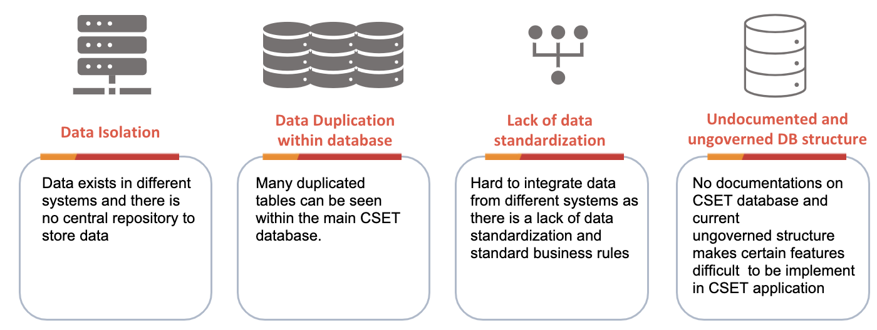
Problem Statement

Slide 13
Objectives
To modernize, revamp, remodel the current CSET old database
To perform data cleaning and model re-structure of current CSET old database
To introduce Data Lake solution to set a foundation for any future data initiatives
To introduce an ETL Platform

Slide 14
Enterprise Data Platform SOW
Proposing and implementing a Data Lake and Metadata-Driven Ingestion Framework as part of the Enterprise Data Platform.
Proposing and implementing a Data Quality Framework within the Enterprise Data Platform.
Assessing and analyzing the existing table structures for redundancies, usage needs, and best practices.
Proposing and implementing a new data model for the CSET database modernization.
Developing a data catalog.
Migrating and loading historical data from the existing structure to the new revamped structure.
Designing, building, testing, and deploying ETL pipelines based on the available requirements.

Slide 15
Application Modernization SOW
Assessing and analyzing the existing CSET application and AS-IS development environment, followed by proposing a TO-BE development cycle plan.
Proposing and implementing frontend (ReactJS) and backend (Laravel) development strategies.
Modernizing and revamping key modules such as Login, RBAC, Search, Customer Profile, Technical Info, Cacti, Network Diagram, VAS Service, Log History, Managed Router, Alarm, Search Module Voice, Customer Profile Voice, Technical info Voice, DID Range Voice, Diagnostics, and Reporting for TCC, SIPTRK, and VOBB.
Migrating the backend from PHP to Laravel and the frontend from PHP to React.js.
Setting up Gitlab and DevOps lifecycle
Integrating TIME’s internal AD with the application and onboarding users to the agreed team roles and committees.

Slide 16
Application Modernization SOW
List of total scope within the application development:
 | Total Modules | Total Scripts | Total Line of Codes
Login | 1 | 3 | 240
RBAC | 1 | 5 | 35
Enterprise | 10 | 10 | 2210
Voice | 5 | 8 | 4350
Reports | 3 | 3 | 2000
All network readiness prepared by customer
The setup of VM readiness prepared by customer
There is no additional scope unless agreed by Quandatics team and customer
There is no Load Balancing

Slide 17
Technology Stack
Requirement | Technology Stack
Front end framework | ReactJS Hook
Back end/Webservice framework | PHP Laravel
API Architecture | Comply to OAS standards HTTP RESTful principles with JSON format
Search processing | Meilisearch
Database | MySQL 8.0/MariaDB
VM OS | RHEL 9.x

Slide 18
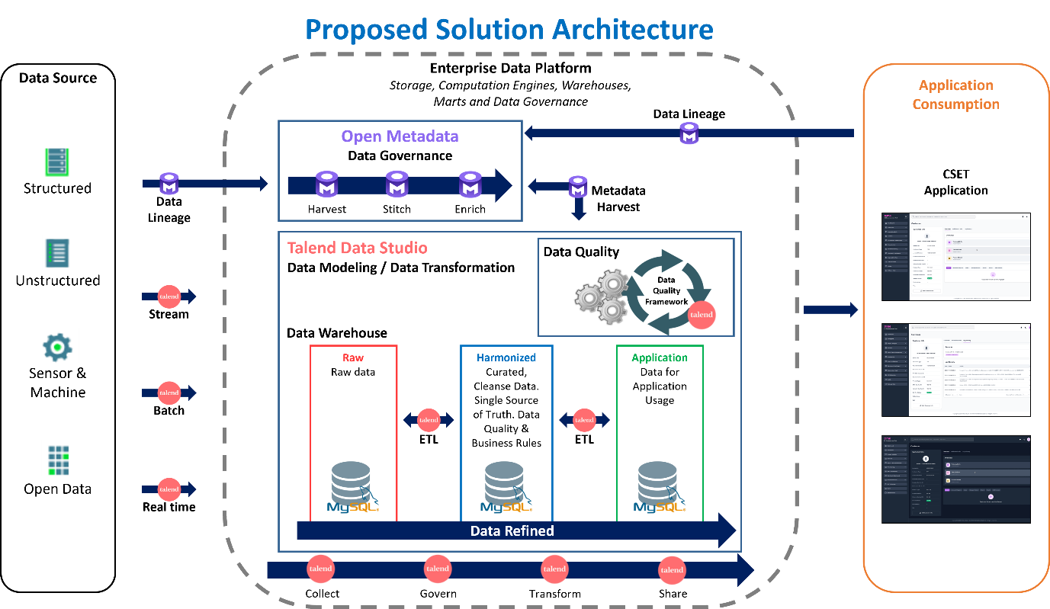

Slide 19
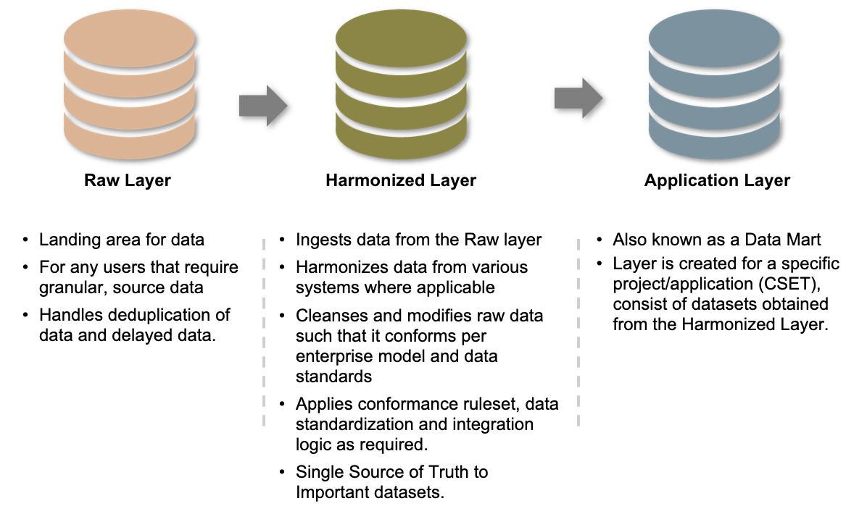
Design and Development of a Data Lake Platform

Slide 20
Metadata-Driven Ingestion Framework
A robust Metadata-Driven Ingestion Framework will be developed to automate and streamline data ingestion into the Data Lake. The framework will feature:
Dynamic table ingestion based on metadata.
Comprehensive logging to monitor ingestion status and track errors.
Support for re-running table ingestion from the last point of failure.
The ability to apply transformation rules during ingestion.

Slide 21
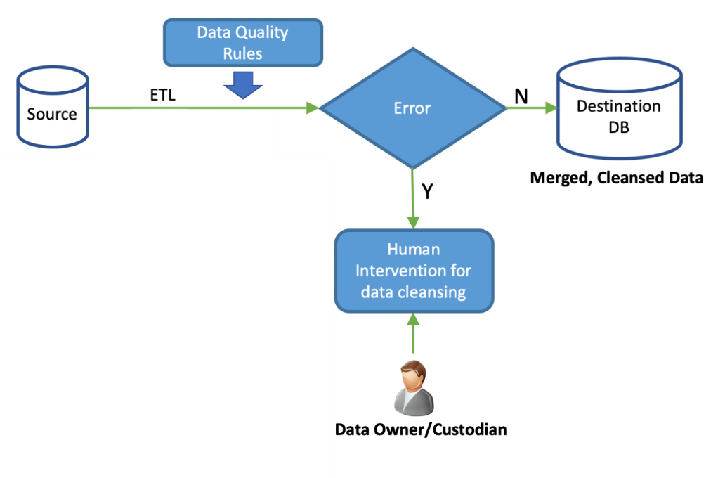
Data Quality Framework

Slide 22
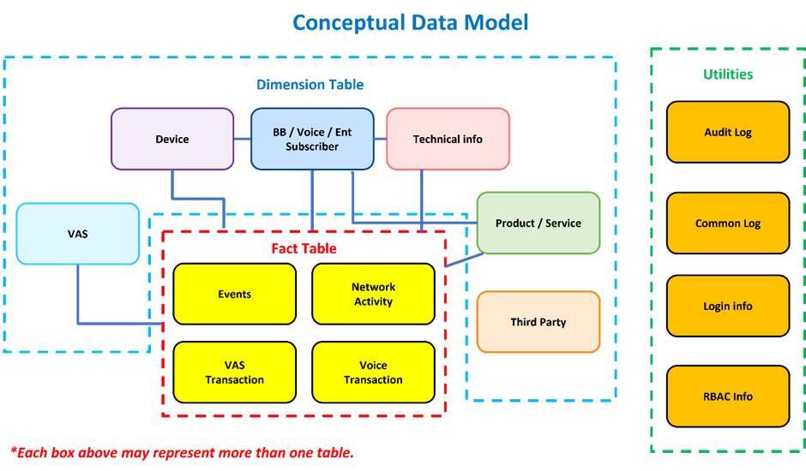

Slide 23



Proposed Technology
End-to-end Data Management Platform
Open connectivity integration
Data filtering, cleansing and quality management
Layered transformation serving diverse needs
Maximize automation
Open-Source Relational Database Management System (RDBMS)
Open-source and Cost-effective
Comprehensive Security Features
Cross-platform and Integration Ready
Open-Source Data Governance Tool
Open-Source and Extensible Architecture
Seamless Integration with Modern Data Ecosystems
Centralized Data Discovery and Governance

Slide 24
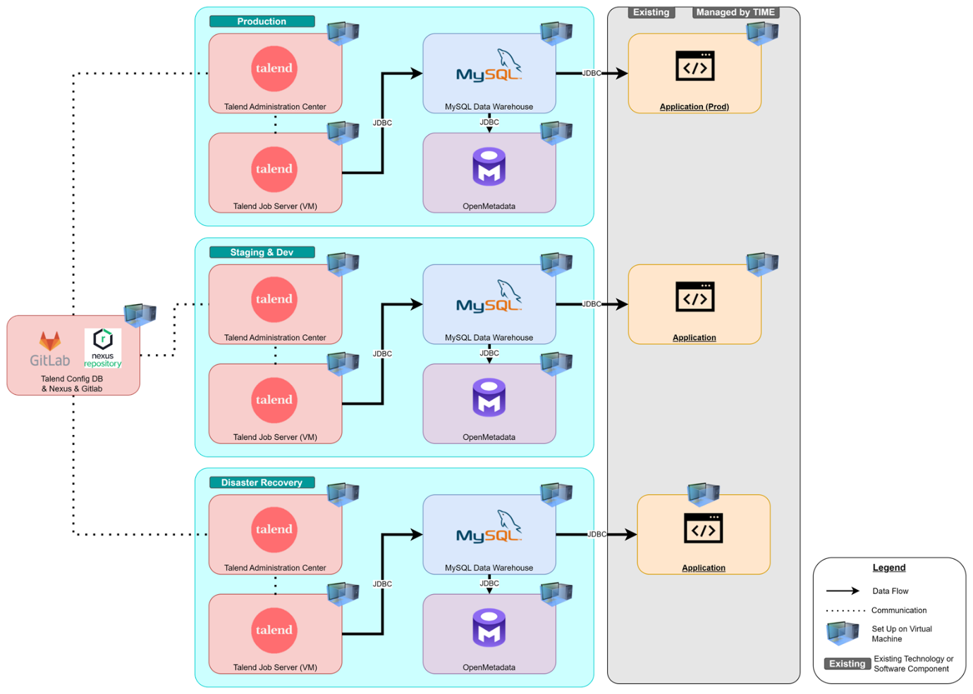
Physical Architecture

Slide 25
Project Implementation Plan
Project Roll Out
Resource mobilization
Refine Project Scope & Implementation Planning
Project Kick-Off
Phase 1a - Platform Readiness and Interim Data Storage
Technical Requirement Study
Phase 1b - Establish Raw Layer/Data Extraction
Phase 1c - Establish Harmonized Layer/Data Transformation
Data Model Design
UIUX design deliverables and verification
Phase 1g - Post Implementation
Production Deployment
Training
Project Closure
Phase 1e - Data Catalogue
Phase 1f - Application Modernization
Metadata Driven Ingestion (MDI) Framework Design
Design Data Governnace and Quality Control per best practices
Project Closure
Phase 1h - Training
Technical Architecture Design & Planning
User Requirement Study (URS)
Enterprise Data Platform Setup
System Integration Test (SIT)
Data Pipeline Development (MDI)
Technical Documentation
User Acceptance Test (UAT)
Data Model Development
Technical Documentation
User Acceptance Test (UAT)
Phase 1d - Establish Data Mart Layer/Data Loading
Data Mart Design
Data Mart Development
Technical Documentation
User Acceptance Test (UAT)
Build Data Catalogue as per best practices
Technical Documentation
User Acceptance Test (UAT)
To produce the high level and low level design document
Application Modernization
User Acceptance Testing
System Go Live
Prepare Documentations
Conduct Knowledge Transfer Sessions
Post Implementation Review
Transition to Support and Warranty

Slide 26
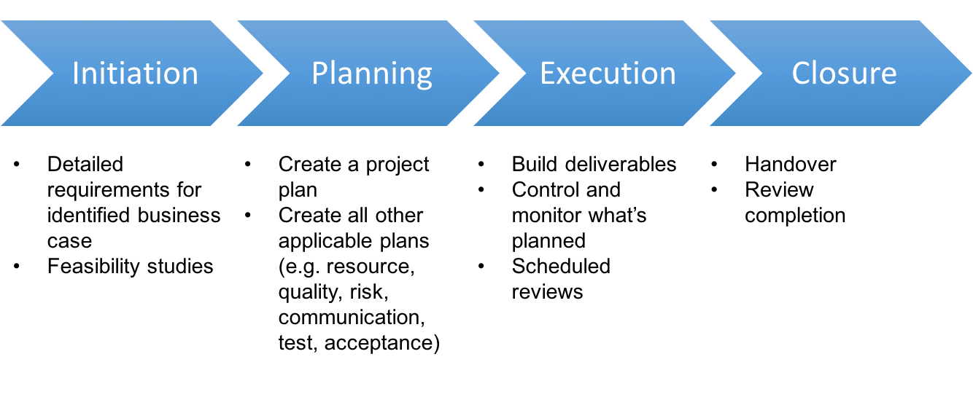
Proposed Management Methodology

Slide 27
Project Timeline

Slide 28
Project Team Structure
Project Manager
Tech Lead
Solution Developer (EDP)
Solution Developer (DG)
Solution Developer (AM)

Slide 29
Project Organization Chart
TIME Dot Com
Quandatics
Meng Kwan, Project Lead
Yen Lian, Senior Engineer
Angeline Project Manager
Fitri, Frontend Engineer
Shaun, Senior Developer
Chun Huei, Fullstack Engineer
Yen Lian, Data Analyst
Chun Huei, Data Analyst
Mok Lee, Senior Data Engineer
Data Engineer 1
Data Engineer 2
Kai Yi, Advisor
Application
Data

Slide 30
Communication Plan – List down Dates
Kick-off Meeting – Date: Involve KK this Thursday 2.30pm
Daily Standup 30 mins sync up (Online Teams)
Progress update meeting (Weekly): Every Thursday onsite 2-4pm @ Glenmarie
Enquiries & Clarifications via Email
Adhoc meetings discussion via Teams / Whatapps
Closure Meeting – N/A

Slide 31
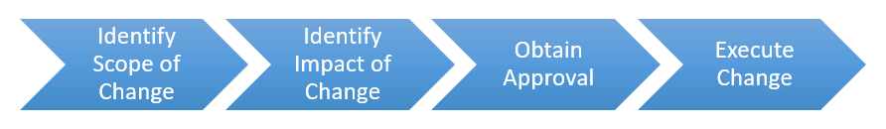
Change Request Management
Steps | Descriptions
Identify Scope of Change | Identifying the changes, typically change on business & technical requirements and the significance of the change request.
Identify impact of Change | Putting together a high-level execution plan, identify the effort required for the change and out lay the impact to the technical design, project scope, timeline and cost involved if applicable.
Obtain Approval | Change management meeting will take place to table the change request, along with the scope of change and its impact on the project, for approval by the change management committee.
Execute Change | Upon approval of the change request, the project team will be notified of the changes and project deliverables shall be updated and documented before executing the required changes.

Slide 32
Quality Management
Quality Management comprises activities and processes that ensure project deliveries meet the required quality standards.
Activity | Descriptions
Unit Test (UT) | Tests a collection of processes to validate that each component performs as expected and meets the functional and technical specifications; Unit tests are executed by the service provider.
System Integration Test (SIT) | Tests of collection of processes developed within a milestone to ensure overall integrity and operability within the solution platform; to be planned and executed by service provider.
User Acceptance Test (UAT) | Tests of collection of processes developed within a milestone to ensure that they achieve the functional requirements identified during the URS; to be planned and guided by service provider and executed by process owners.

Slide 33
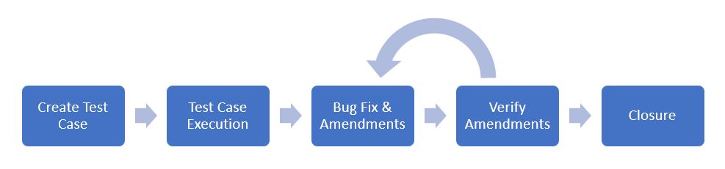
Quality Management – Test Cycle

Slide 34
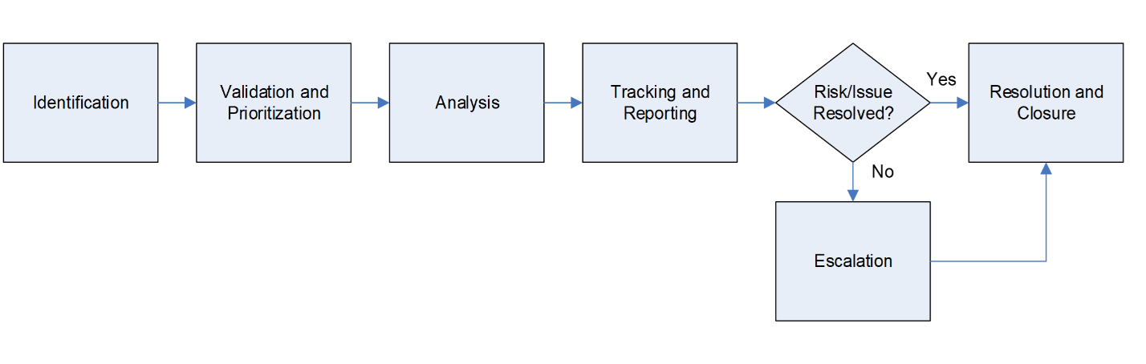
Issue Management

Slide 35
Project Documentations Deliverables
Stages | Documents
Initiation | Project Management Plan System Requirement Specification Architecture Diagram System Integration Test script (SIT) System Installation Guide
Implementation Requirement study Planning & Design Monitoring Deployment | User Requirement Specification (URS) System Design Specification (SDS) Weekly Status Report Minutes of Meeting User Acceptance Test (UAT)
Closeout Support Maintenance | Knowledge Transfer Document Post Live Operation Manual Warranty Terms and Conditions
Defects Logs
Change request (CR) (if applicable)
Final Acceptance Test (FAT)
Go live Sign-Off
Customised Training Materials

Slide 36
Support, Maintenance & Warranty
The software support & maintenance covered under this proposal are:
2 months warranty and support on the solution delivered
Yearly technical support as presented in the table below
Item | Description
Support on COTS Software Platform | COTS software platform is software that are publicly available provided by the software principal for duration of software subscription.
Vendor Extended Support | Solution built by our professional service delivery team (E.g. ETL Pipelines, Dashboards, applications, etc.), valid within subscription term.

Slide 37
Vendor Solution Service Level Agreement (SLA)
Severity of Request | Definition | Response Time | Resumption on Time | Resolution on Time
Severity 1 | Failure affecting majority of the solution to the extent that no productive work can be carried out or is completely inoperable. | Acknowledge within 2 business hours. | Response with a resolution within 4 business hours. | Target to complete resolution within 4 business hours.
Severity 2 | Failure affecting only a subset of the solution and service level dropped significantly. If unattended, issue/problem may lead to Level 1 Severity. | Acknowledge within 4 business hours. | Response with a resolution within 8 business hours. | Target to complete resolution within 16 business hours.
Severity 3 | Solution failure has not impacted the business yet (due to build-in redundancy / high availability design and features). However, if problem/issue does not resolve it could lead of a higher severity problem. | Acknowledge within 1 business day. | Response with a resolution within 2 business days. | Target to complete resolution within 3 business days.
Severity 4 | Technical enquires/clarification | Acknowledge within 2 business days. | Response with a resolution within 3 business days. | Target to complete resolution within 7 business days.

Slide 38
Assumptions
The entire project proposal is formed, written, and proposed based on the following assumptions. Should any of the assumptions be invalidated, the team will need to assess if there is a need for rescope or change request:
The current resource allocation and project timeline are based on assumptions regarding the quantity of existing data sources and the expected outputs to be generated during implementation. These assumptions may be refined once more detailed information about data sources and use cases becomes available.
TIME will provide sufficient briefing and documentation on current state to enable Quandatics team to carry out the necessary task.
TIME will make the necessary decisions and approvals on a timely basis.
TIME and identified stakeholders will provide the necessary information and documents on a timely basis, and that good data / information quality is provided. TIME will address all queries and revisions (if any) on a timely basis.
TIME and identified stakeholders are available for discussions and meetings when required.
Public holidays and extended public holidays are not accounted for.
Both parties maintain project management best practices to communicate any project events / issues in a timely manner.

Slide 39
Assumptions
The Tenderer proposed a 5-man team (1 project manager, 1 tech lead and 3 solution developers) as the maximum number of resources to be mobilized. Within this resource pool, the allocation of personnel at a point in time to priorities will be further discussed come project initiation which is also subject to the mode of the project implementation for the priority use cases (fully sequential, concurrent or hybrid).
Upon confirmation of the project award with Purchase Order (PO) or Letter of Award (LOA), resources will be ready and can be mobilized in a maximum of 2 weeks from date of award. Should there be a need to expedite this duration, a formal Notice-To- Proceed (NTP) can be issued with the expected start date to pre-empt and allow the vendor team to mobilize resources while waiting for the purchase order (PO) to be issued.
For open-source software platform that do not come with an active subscription, will be excluded from SLA.
Proposing and implementing a new data model for the CSET database modernization, covering up to the tables and data sources shared by TIME, as outlined in Appendix 2, Technical Matrix, Sections I and J.

Slide 40
Exclusions / Assumptions
Item / Description | Exclusions / Assumptions
Global/ Local Load Balancer | Hardware or Software components which require the capability of global/local load balancing must be prepared by the end user. Excluded from Quandatics cost.
MySQL database | Currently default proposed services setup using: Active - Passive/Standalone database setup using features allowed in open-source database community edition (free) software. For production and staging and DR, community edition features utilised. For development, standalone setup. Additional remarks for exclusions: Active-Active Cluster setup with minimum downtime would require both enterprise DB license and additional services to setup and design the architecture. Quandatics would prepare the necessary services to enable this function via MySQL software solution, excluding backup hardware or software enterprise paid solutions that are outside of MySQL capabilities.
DR Replication | Quandatics would prepare the necessary services to enable this function via MySQL software database solution, excluding backup hardware or software enterprise paid solutions that are outside of MySQL capabilities
Backup Solution | Quandatics would prepare the necessary services to enable this function via MySQL and Talend and Application solution, excluding backup hardware or software enterprise paid solutions that are outside of our capabilities.

Slide 41
Q&A
Work arrangements (logistics)
PMO structure
Communications plan
VM specifications request raised by Chun Huei
Data access/VPN/platform access/Database
Need the list of tables and Access of Tables - template from Mok Lee
Application Modules : Using Keycloak or others
VPN Form to fill up by all engineers – 4 engineers
Things require from TIME
20 tables for Data Catalog – Take 1 table and show POC
Assessment and Study for Data Integration to Huawei DWS – High Level Architecture/Planning
- Load data (Data team) - Huawei Data Mart Storage
- Read Application (Shaun)
Talend DI Gold License 1 Year – 1 User to activate on July

Slide 42
Payment Milestones
Payment Term and Milestone for Year 1 only
Down payment 10% upon PO issuance.
10% upon each phase sign-off by OSS e.g., Phase 1a signed-off shall issue payment to vendor.
License will be 100% upon invoiced upon software license delivered
Phase 1a: 10% Payment of total phase 1a value upon phase 1a completion with relevant documents uploaded to SRM portal
Phase 1b: 10% Payment of total phase 1b value upon phase 1b completion with relevant documents uploaded to SRM portal
Phase 1c: 10% Payment of total phase 1c value upon phase 1c completion with relevant documents uploaded to SRM portal
Phase 1d: 10% Payment of total phase 1d value upon phase 1d completion with relevant documents uploaded to SRM portal
Phase 1e: 10% Payment of total phase 1d value upon phase 1e completion with relevant documents uploaded to SRM portal
Phase 1f: 10% Payment of total phase 1d value upon phase 1f completion with relevant documents uploaded to SRM portal
Phase 1g: 10% Payment of total phase 1d value upon phase 1g completion with relevant documents uploaded to SRM portal
Phase 1h: 10% Payment of total phase 1d value upon phase 1h completion with relevant documents uploaded to SRM portal
10% upon end of 6 months warranty from Phase 1h completion date.
Payment Term and Milestone for Training and CR 100% payment term upon invoiced

